Slide 1
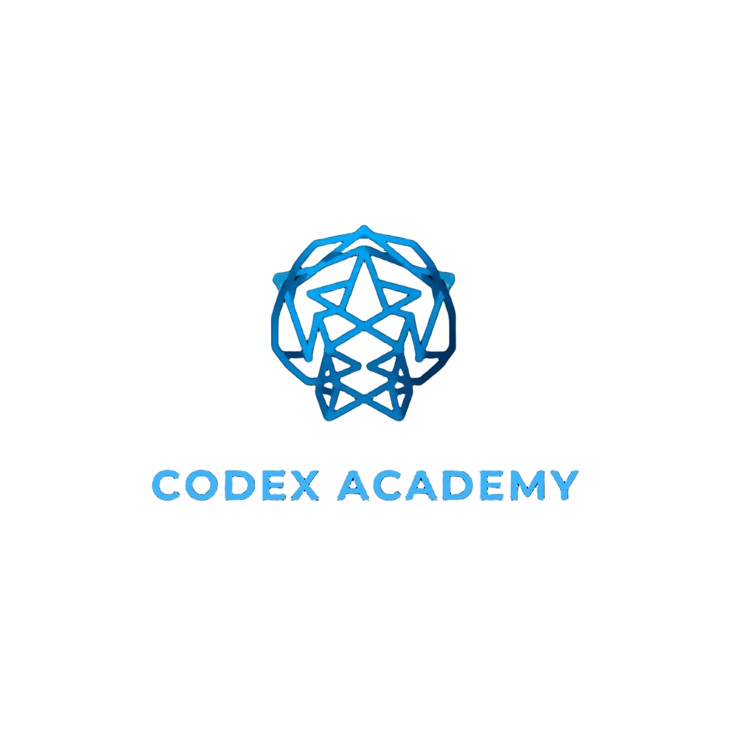
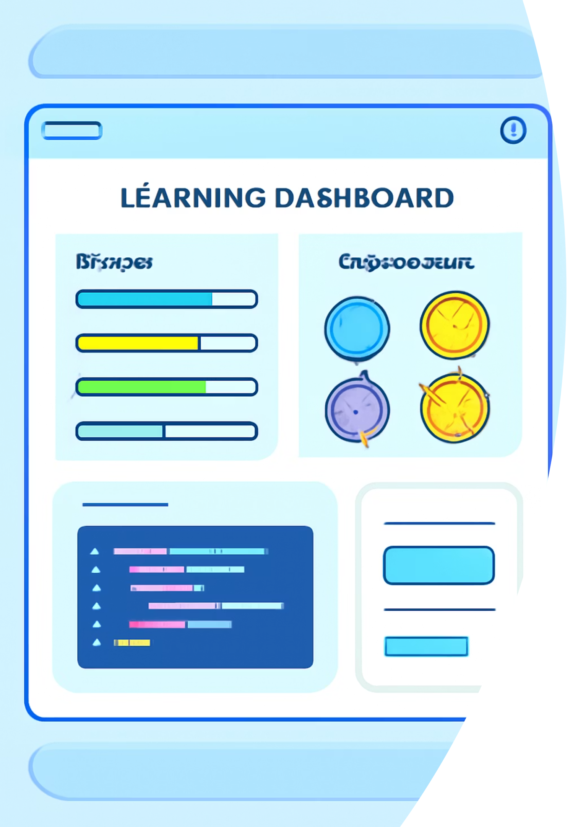
CODEX Academy: Gamified Programming Education
A motivating, professional introduction to CodeQuest Academy — a C++ & Qt desktop app that teaches programming through gamified lessons, AI help, and polished dark UI.

Slide 2

Who it's for
Students, community learners, and beginner developers in Egypt who prefer interactive, bite-sized learning on the desktop. Ideal for learners who want hands-on practice with immediate feedback and clear milestones.

Slide 3
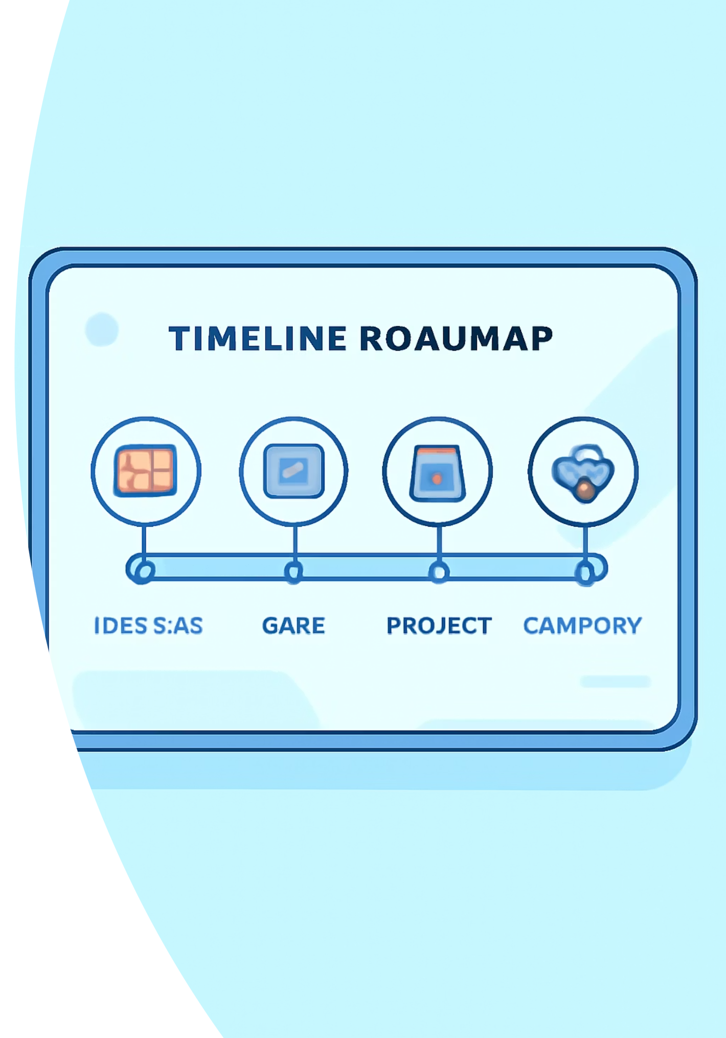
Learning Roadmap — Smart Progression
Structured modules unlock automatically: watch a lesson video → pass a quiz → complete a mini-project. Adaptive rules let stronger learners skip redundant repeats while ensuring mastery before advances.
01
02
Video Lessons
Interactive Quizzes
Short focused videos (5–12 minutes) that teach one concept at a time.
Auto-graded quizzes validate understanding; thresholds control unlocking.
03
Micro Projects
Hands-on tasks that reinforce concepts and generate portfolio pieces.

Slide 4
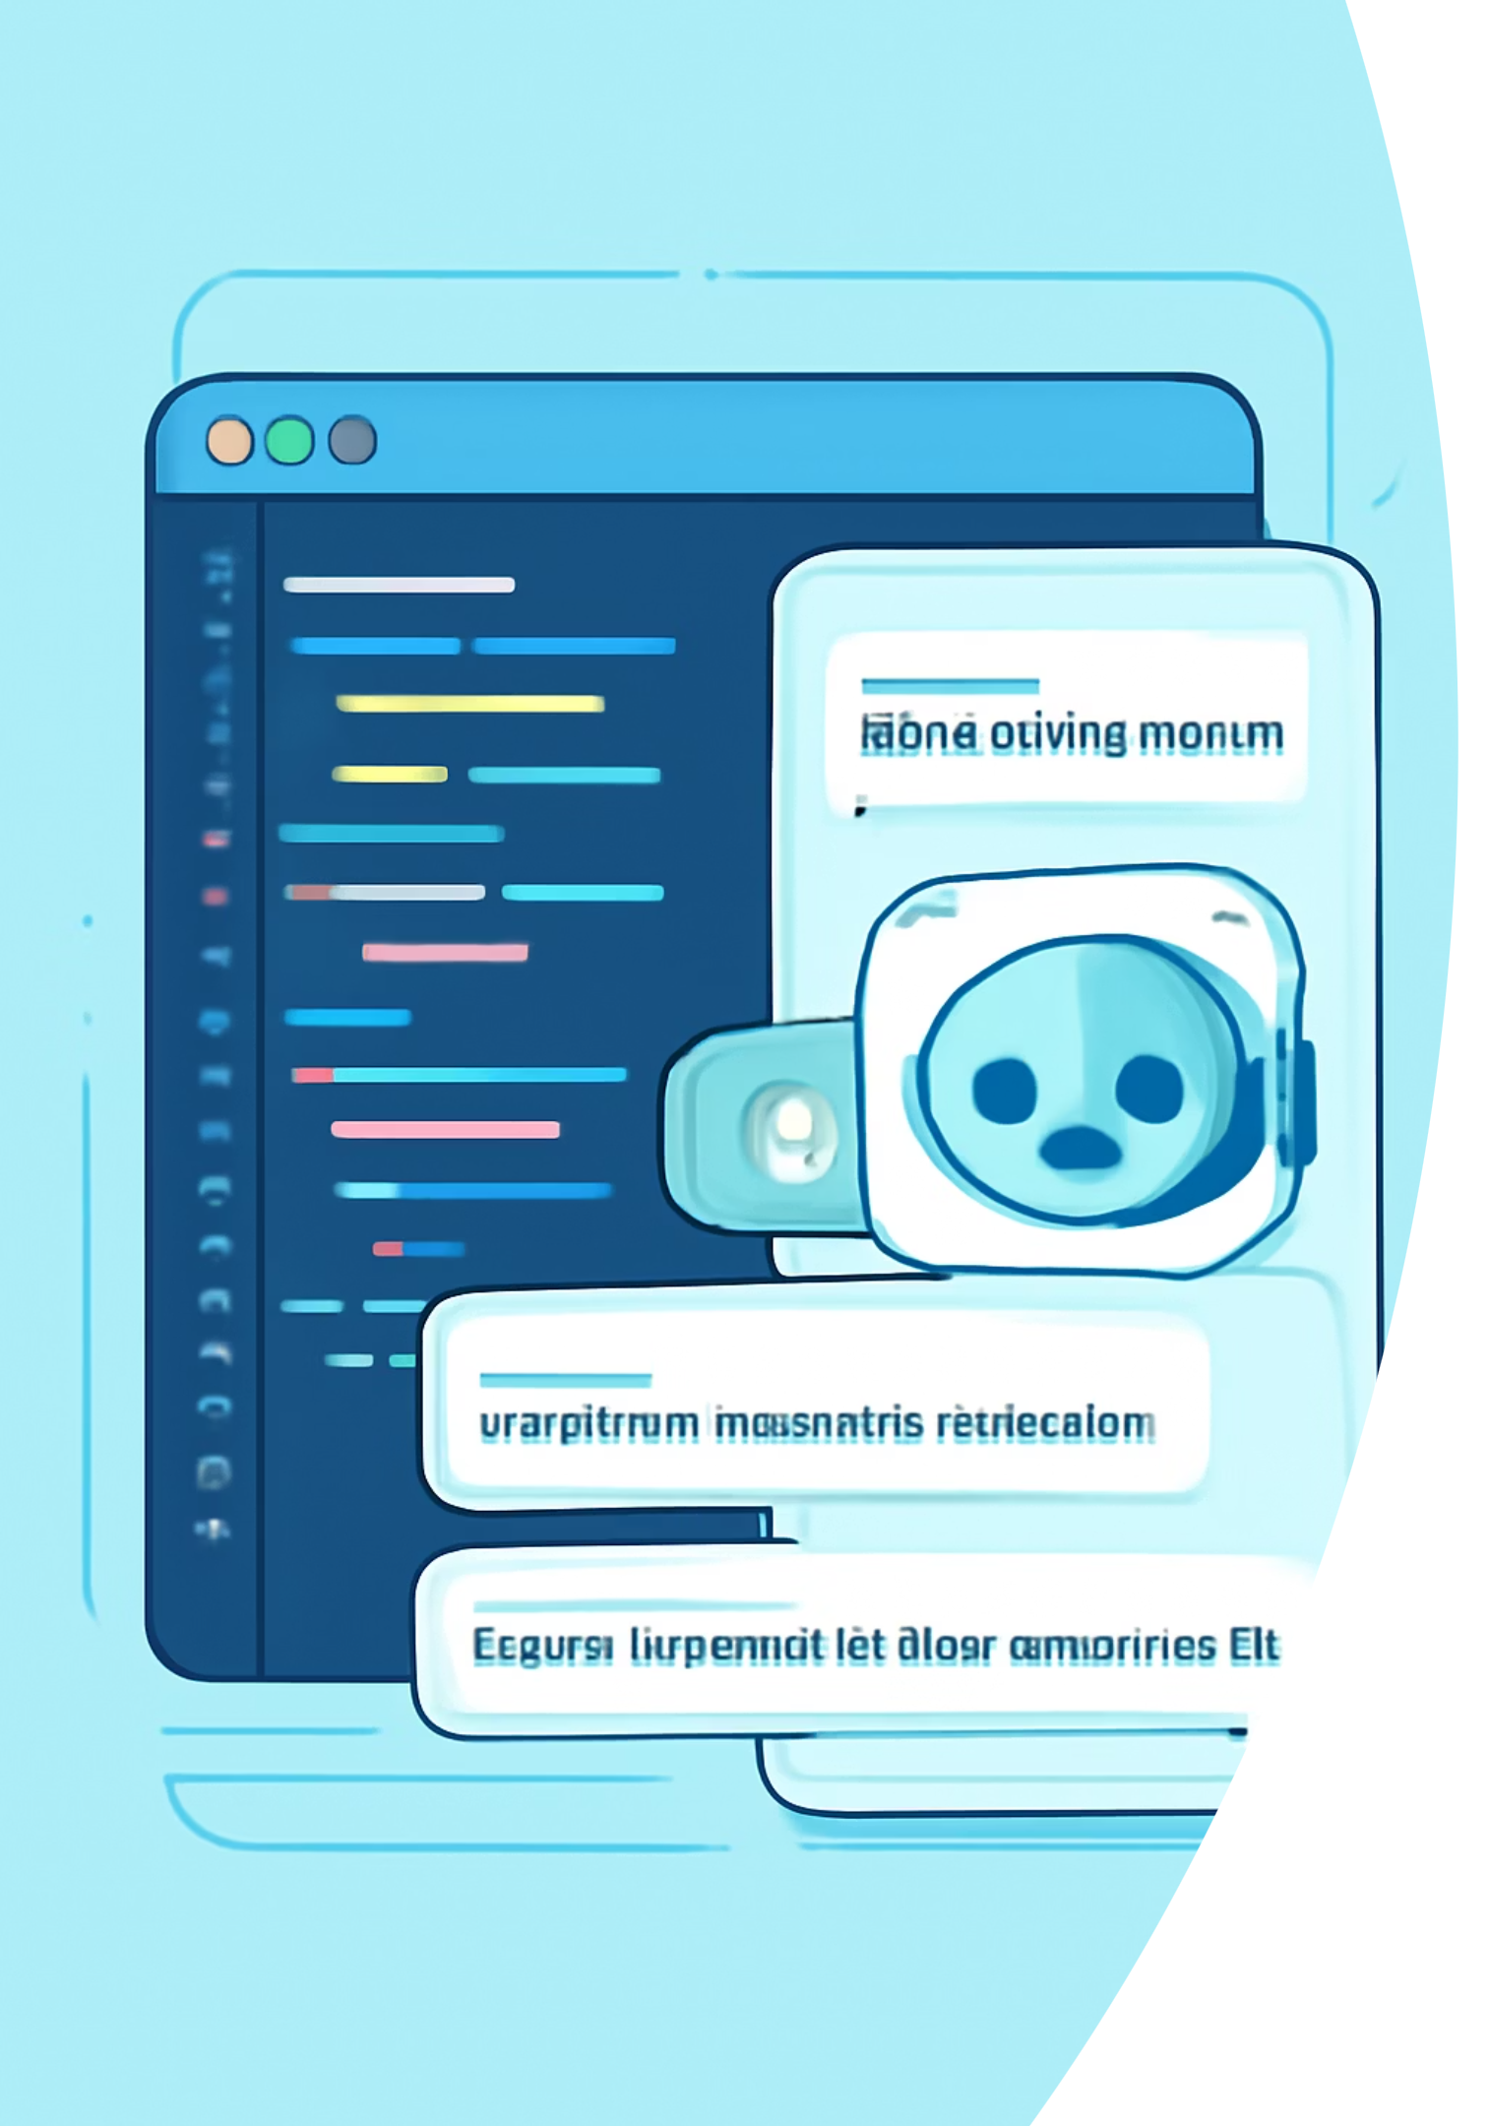
AI Assistant — Real-time Debugging & Guidance
Cloud-integrated AI helps students debug, explains logic in Arabic, and suggests incremental fixes. Students can request hints, code examples, or conceptual summaries without leaving the app.
Contextual Help
Detects errors from compiler output and suggests targeted fixes.
Explain Like I'm 5
Breaks down complex concepts into simple, step-by-step explanations in Arabic.
Safe Mode
Filters unsafe operations and gives secure coding recommendations.

Slide 5
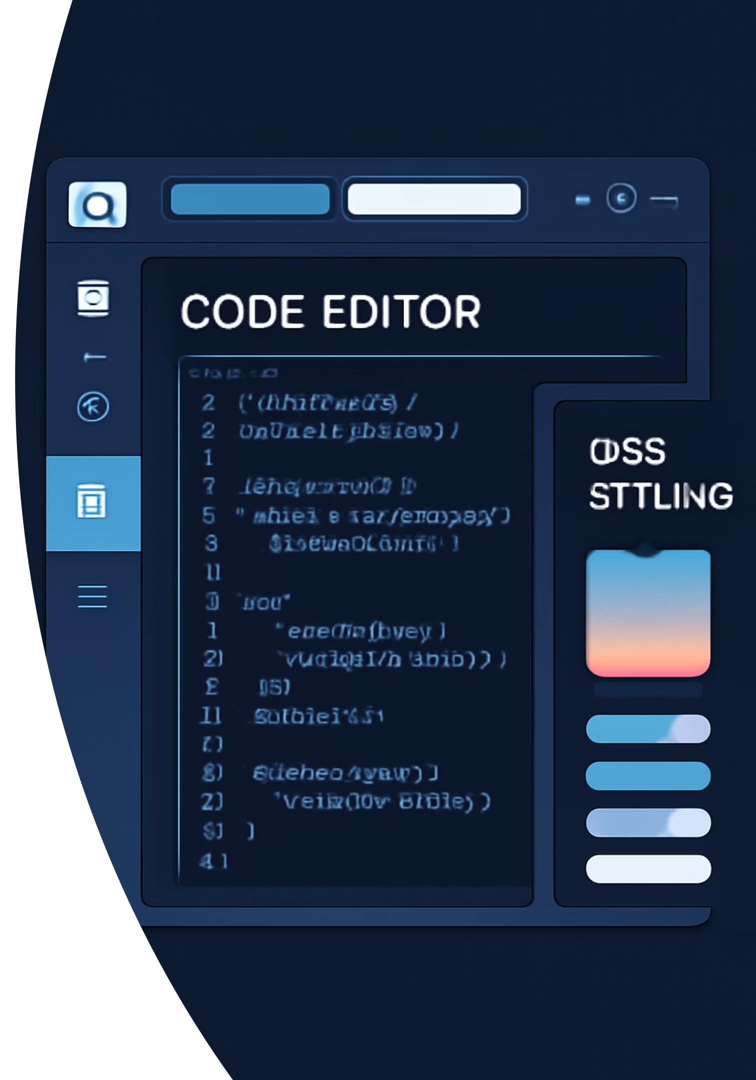
Custom Dark Theme — Polished Desktop Experience
Premium dark theme implemented with advanced Qt Style Sheets (QSS): consistent typography, accessible contrast, subtle motion, and theme accents using brand colors.
Responsive Layouts
QSS-driven
Accessibility
Reusable style tokens for buttons, inputs, and code panes.
High-contrast modes and keyboard navigation for inclusive learning.
Resizes smoothly across screen sizes and resolutions on desktop.

Slide 6
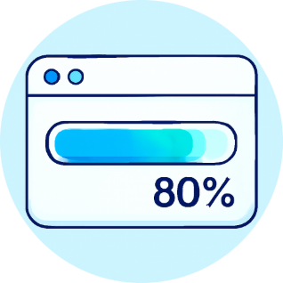
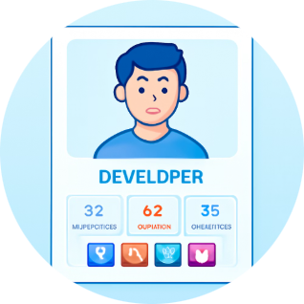

Progress Tracking & Motivation
Dynamic XP bars, tiered badges, and personal profiles motivate learners with visible growth and social sharing options to celebrate milestones.
Achievement Badges
XP & Levels
Detailed Profiles
Earn badges for concepts mastered and mini-projects completed.
XP is awarded for lessons, quizzes, and peer reviews; level unlocks content and cosmetic rewards.
Track strengths, weak areas, and suggested revision paths.

Slide 7
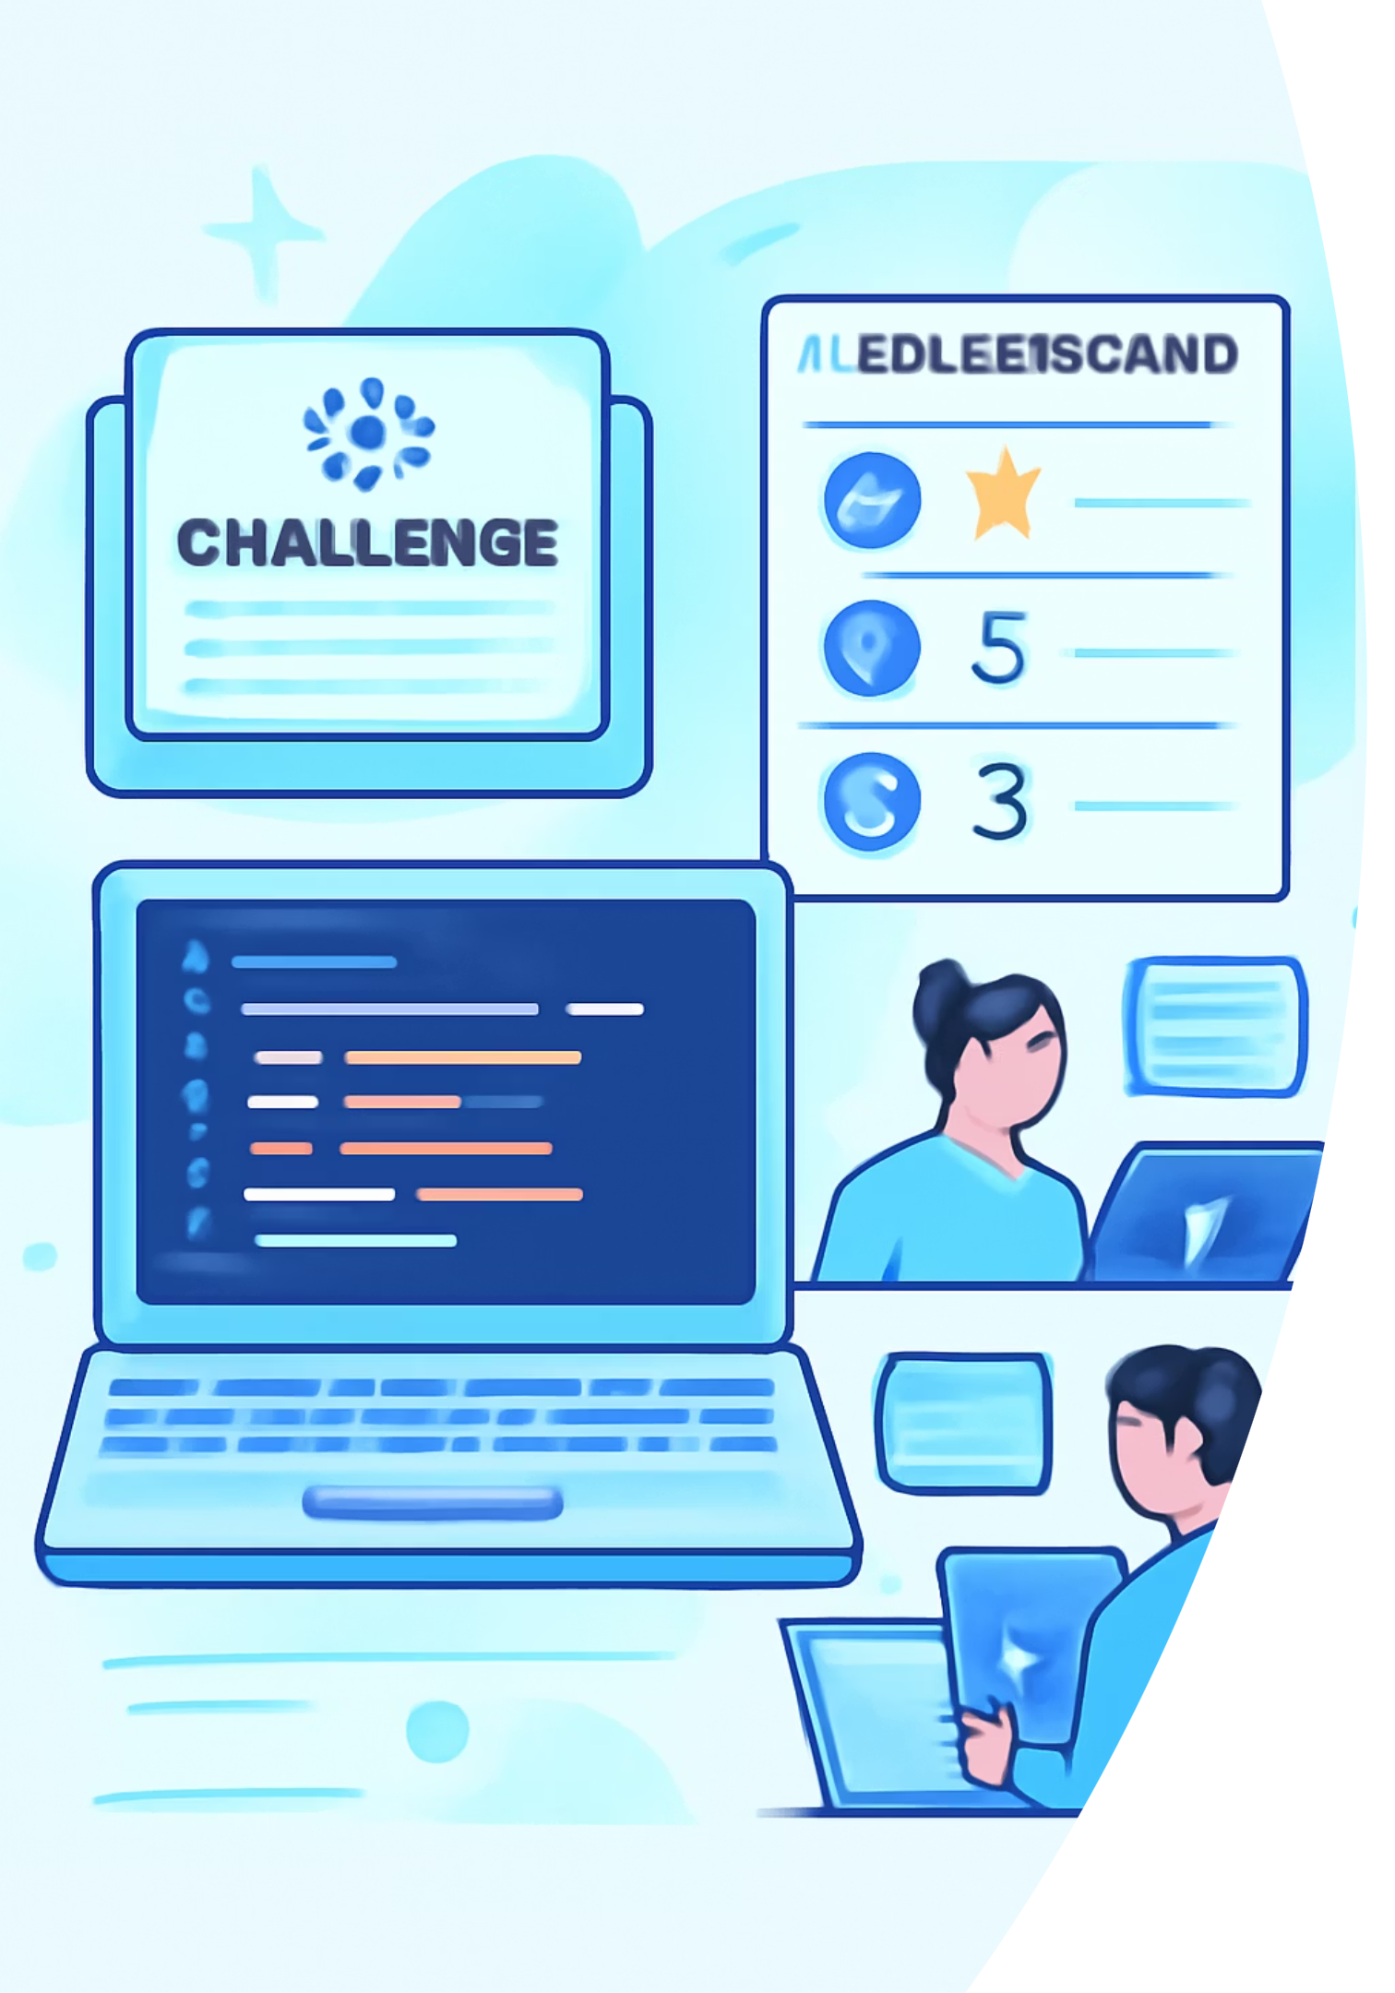
Community & Social Learning
Integrated leaderboards, peer review of micro-projects, and community challenges create a supportive learning ecosystem that rewards collaboration.
Leaderboards
Friendly competition with weekly challenges.
Peer Reviews
Students give feedback, improving both reviewers and authors.
Study Groups
Form topic-based squads for sustained practice and mentorship.

Slide 8
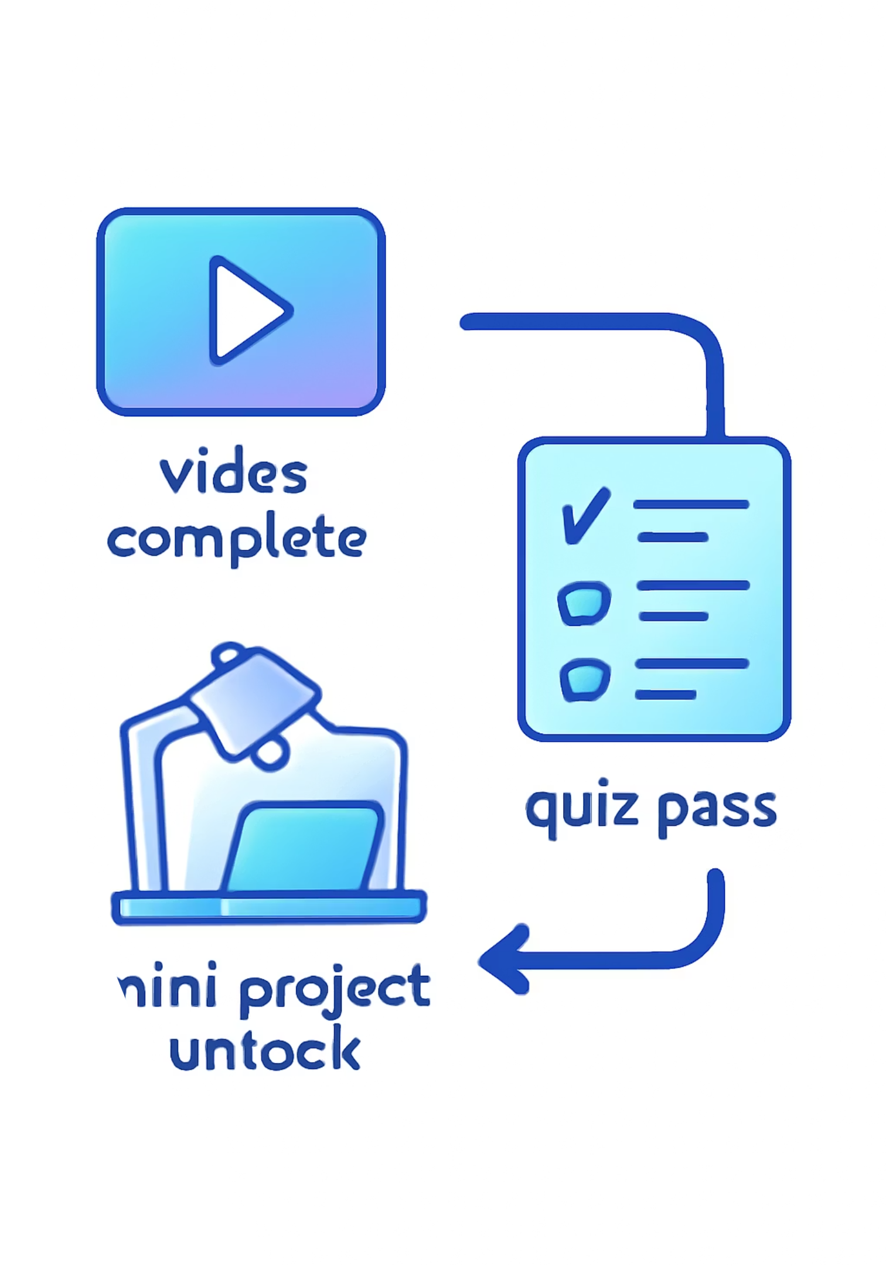
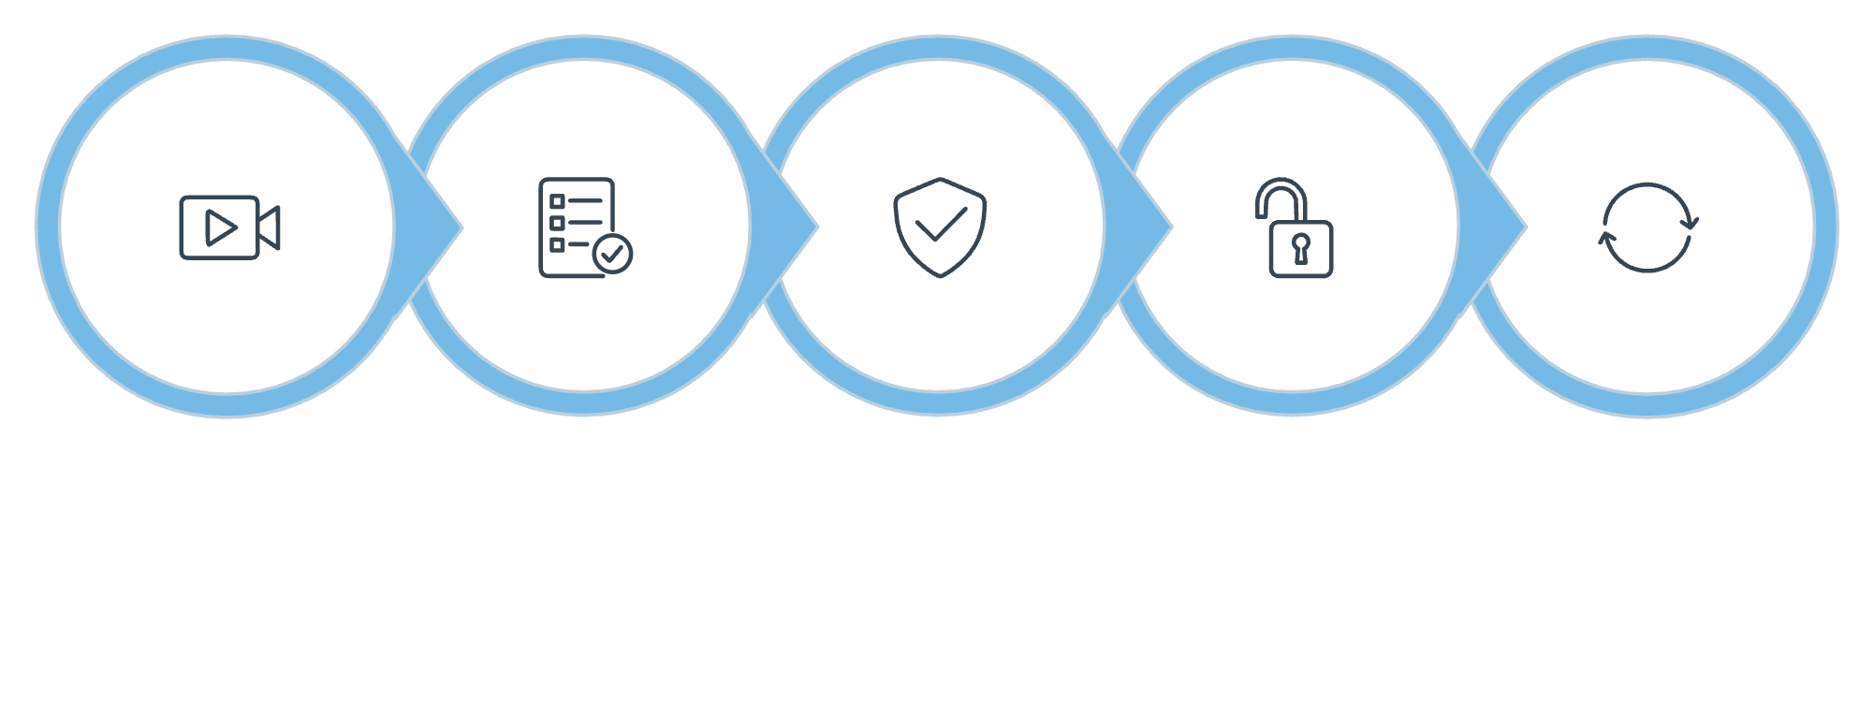
Architecture — How Smart Progression Works
Video Completed
Quiz Attempt
Pass Threshold
Unlock Next
Retry Path
The system evaluates completion events and quiz scores, applies rule sets (pass thresholds, retries, exemptions), and updates the learner's state in real time.

Slide 9
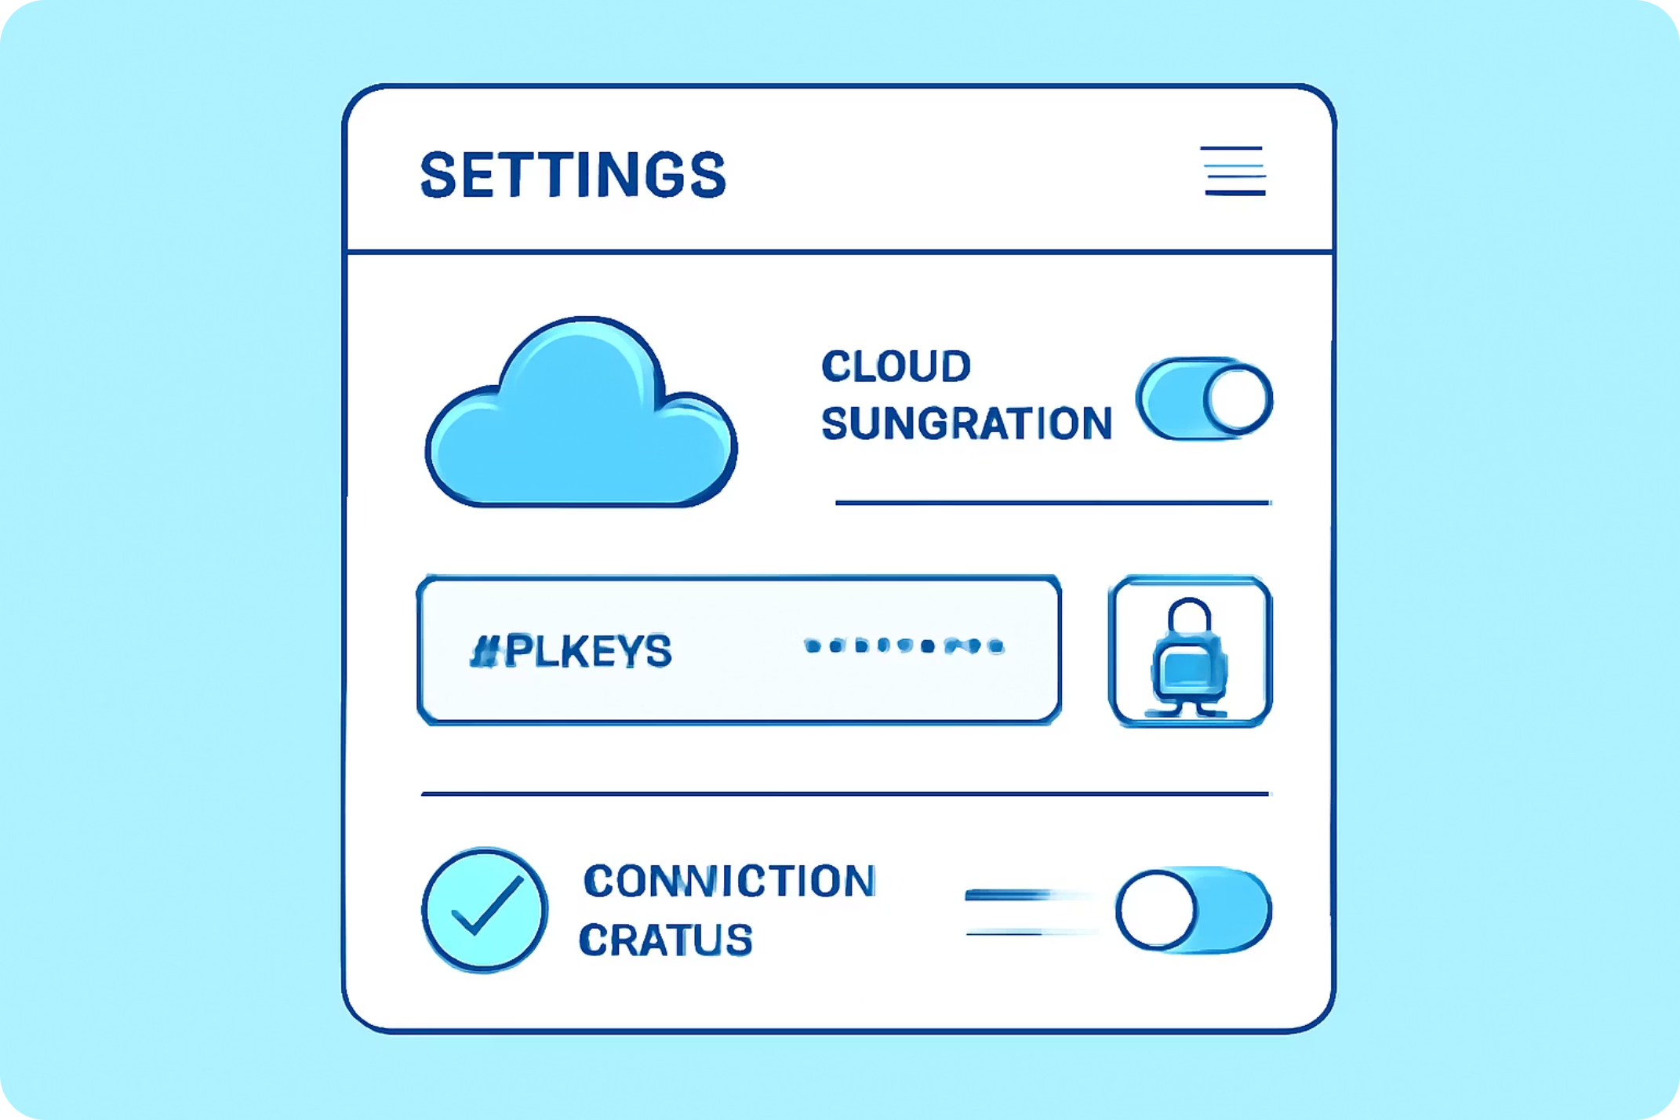
Tech Stack & Scalability
Built with C++ and Qt for native desktop performance. Cloud services power the AI assistant and analytics; modular plugins allow future language support and new content packs.
Data
Core
AI
Analytics for progress, adaptive recommendations, and A/B experiments
C++ (core logic) + Qt (UI, QSS)
Cloud-based assistant (secure API integration)

Slide 10


Next Steps & Call to Action
Pilot with a university cohort — gather feedback and telemetry.
Localize curriculum and AI responses into Arabic (Egyptian dialect).
Open community content contributions and student showcases.
Prepare SDK for plugin lessons and third-party integrations.
Want this deck adapted for instructors or a technical spec? I can generate a speaker script, onboarding checklist, or developer API overview in Arabic.

